Slide 1
How demographic trends will bring economic change in coming decades (US and World)
Ronald Lee
UC Berkeley, Professor in the Graduate School
American Association of Individual Investors -- Los Angeles
November 13, 2021

Slide 2
Worry for what aging will do to economies.

Slide 3
Many concerns.
Some seem right, some wrong, some highly uncertain.
Economic growth will slow as pop growth slows or turns negative (Yes).
Older workers are technophobic, immobile, dull, unproductive so aging will slow productivity growth (No).
Public support systems like Social Security will collapse (Require balancing).
“Asset price meltdown” as elderly try to sell assets to fewer middle aged folks (No).
Rising wages, falling profit rate as capital rises relative to labor (Yes).
Reduced inequality due to rising wages relative to profit rate (Yes).
“Secular stagnation” with interest rates dropping to zero and still no one borrows to invest in new projects because expect slow growth (Maybe).

Slide 4
I will draw on results from the National Transfer Accounts project
Started by Andy Mason and myself about twenty years ago
Now has research teams in 70+ countries.
Estimates economic behavior by age and income flows between ages through family, market and state.
Website: ntaccounts.org
Forthcoming paper: Andrew Mason, Ronald Lee, and 71 members of the NTA network (2021) “Global population change will bring slower GDP growth, convergence in living standards, and greater wealth: Evidence from 186 countries” Population and Development Review.

Slide 5
Population change and the economy in the US (first part of talk)
After years of stable demographic trends in US, there have recently been surprises.
But population aging is not a surprise, it is coming for sure, on schedule.
What will it mean for the economy?

Slide 6
1. Surprising changes in US demography

Slide 7
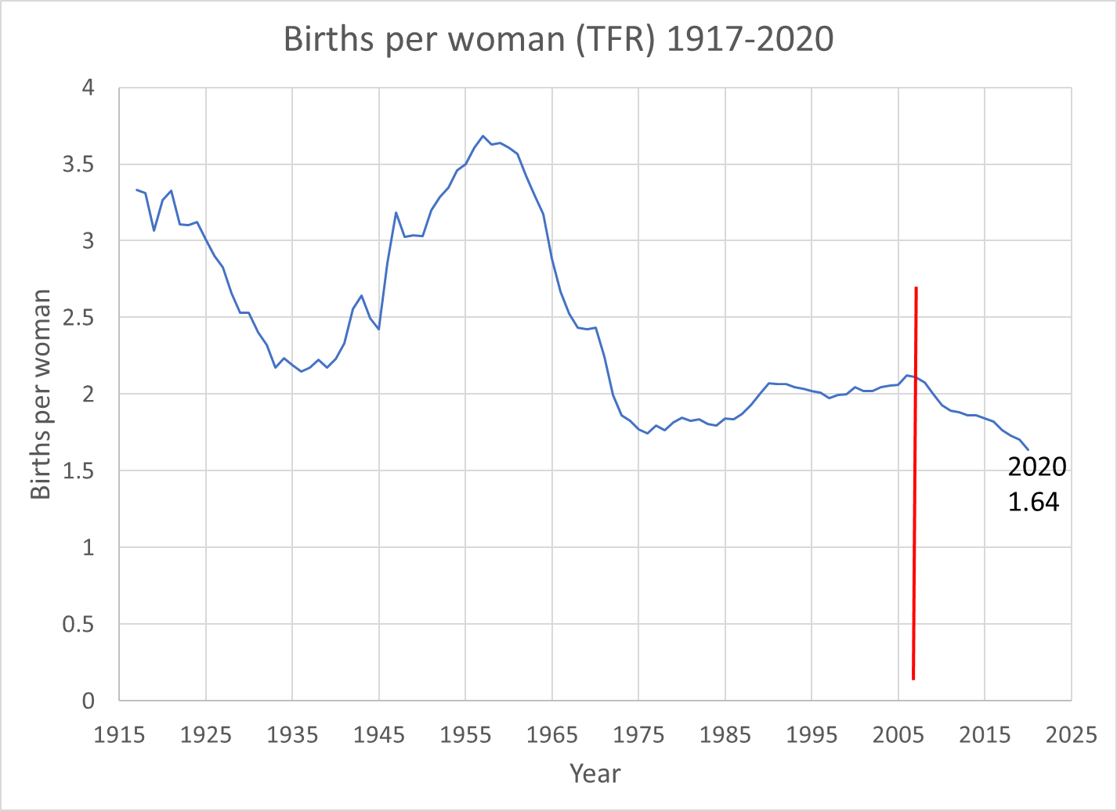
Massive Baby Boom dominates subsequent US demography. No surprise there.
2007
2.11

Slide 8
Fertility dropped in the Great Recession – no surprise there either.
2007
2.11

Slide 9

Surprise is it kept heading down after recession ended.
We have lost half a birth per woman.
2007
2.11

Slide 10
Why has it declined? These factors explain much of the decline
Increased education of women
Rising costs of child care
Rising wages of women relative to men
Postponement of birth to later ages
Reduction by a third in unintended births.
2007
2.11

Slide 11
We have joined the low fertility club of other rich nations
Will fertility continue to be low? Probably.
If so, population and labor force growth rate will drop by .7% per year and increase pop aging.
Social Security Administration assumes fertility will return to pre-Recession levels at 1.9 births per woman...it might, or might not.

Slide 12
Now consider mortality topics which matter for
Life insurance industry
Annuities
Pensions
Longevity swap industry
As well as population aging and general wellbeing.

Slide 13
Life expectancy in top 40 countries in World, 1980-2015. US went from 20th to last.
US
Source: Fig 1-3 in National Academies Report, 2018.

Slide 14
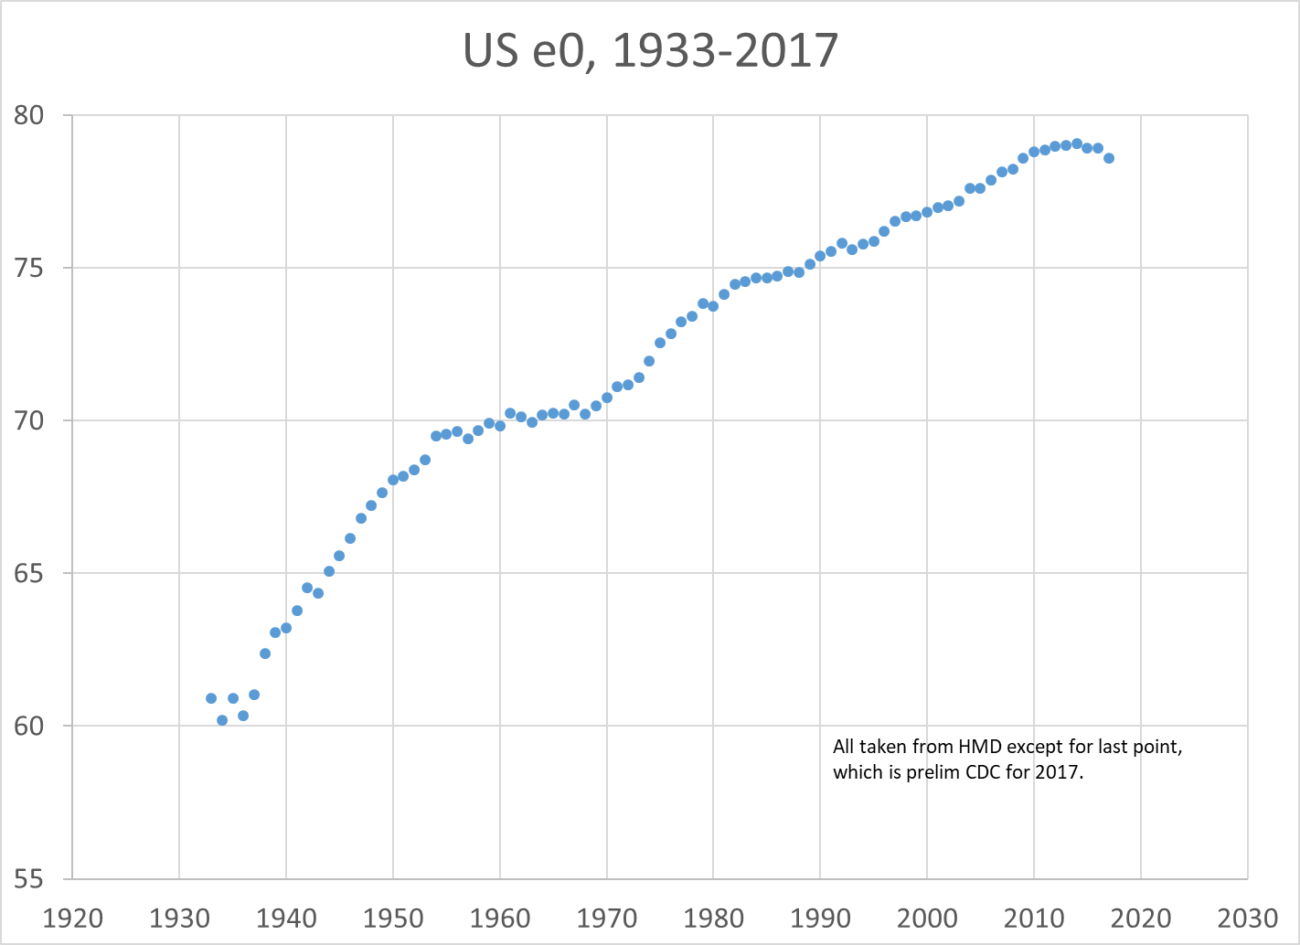
Since 2014 a stunning reversal of trend in US life expectancy

Slide 15
After many decades of trending upward, now three years of decline
Decline
Slowdown

Slide 16
We have lost one year of life relative to trend.
Decline
Slowdown
Life expectancy dropped .3 or .4 years from 2014 to 2017.
Should have risen by .5 years.
We have lost about one year of life in last three years before covid.

Slide 17
Since 2017 it has increased modestly:
  2017 78.6
  2018 78.7
  2019 78.8
  2020 77.3 (drop due to Covid 19).

Slide 18
Elsewhere life expectancy has continued to rise.
Why did it decline in US?
“Deaths of Despair” – rising suicide, drug overdoses, alcohol deaths, particularly for low education whites of working ages.
Obesity and diabetes
Smoking
Widening social class differences in mortality in US.

Slide 19
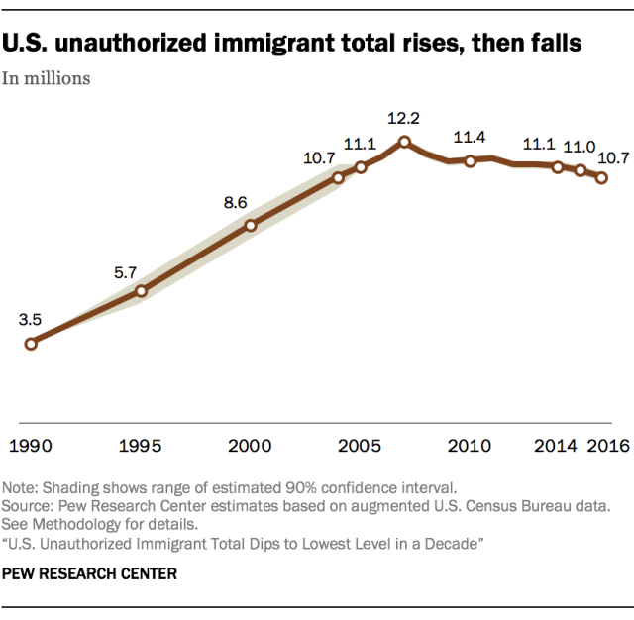
The unauthorized immigrant population increased by 500,000 per year 1990 to 2007, then started to decline in recession.
Dec 3, 2018

Slide 20
Undoc Mexican population in US declined by 1.5 million since 2007; from other places held steady.
10.5
2017
Dec 3, 2018

Slide 22
2. US population is aging fast: slower labor force growth more dependent elderly

Slide 23
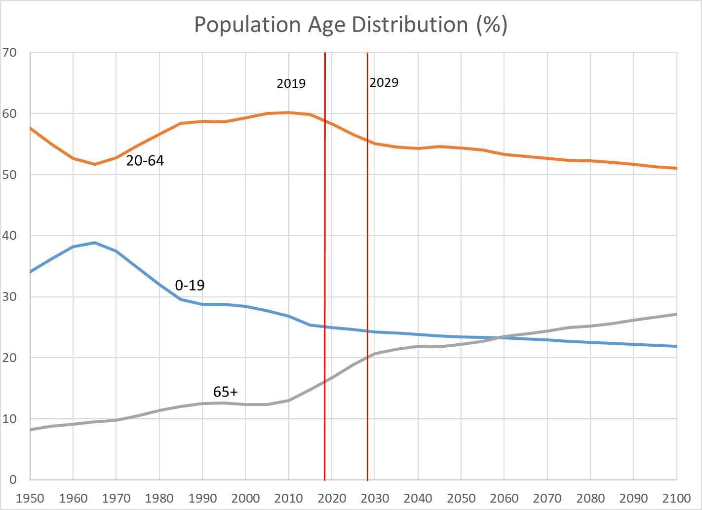
Population Aging, 1950-2015 and projected to 2100 (United Nations)

Slide 24
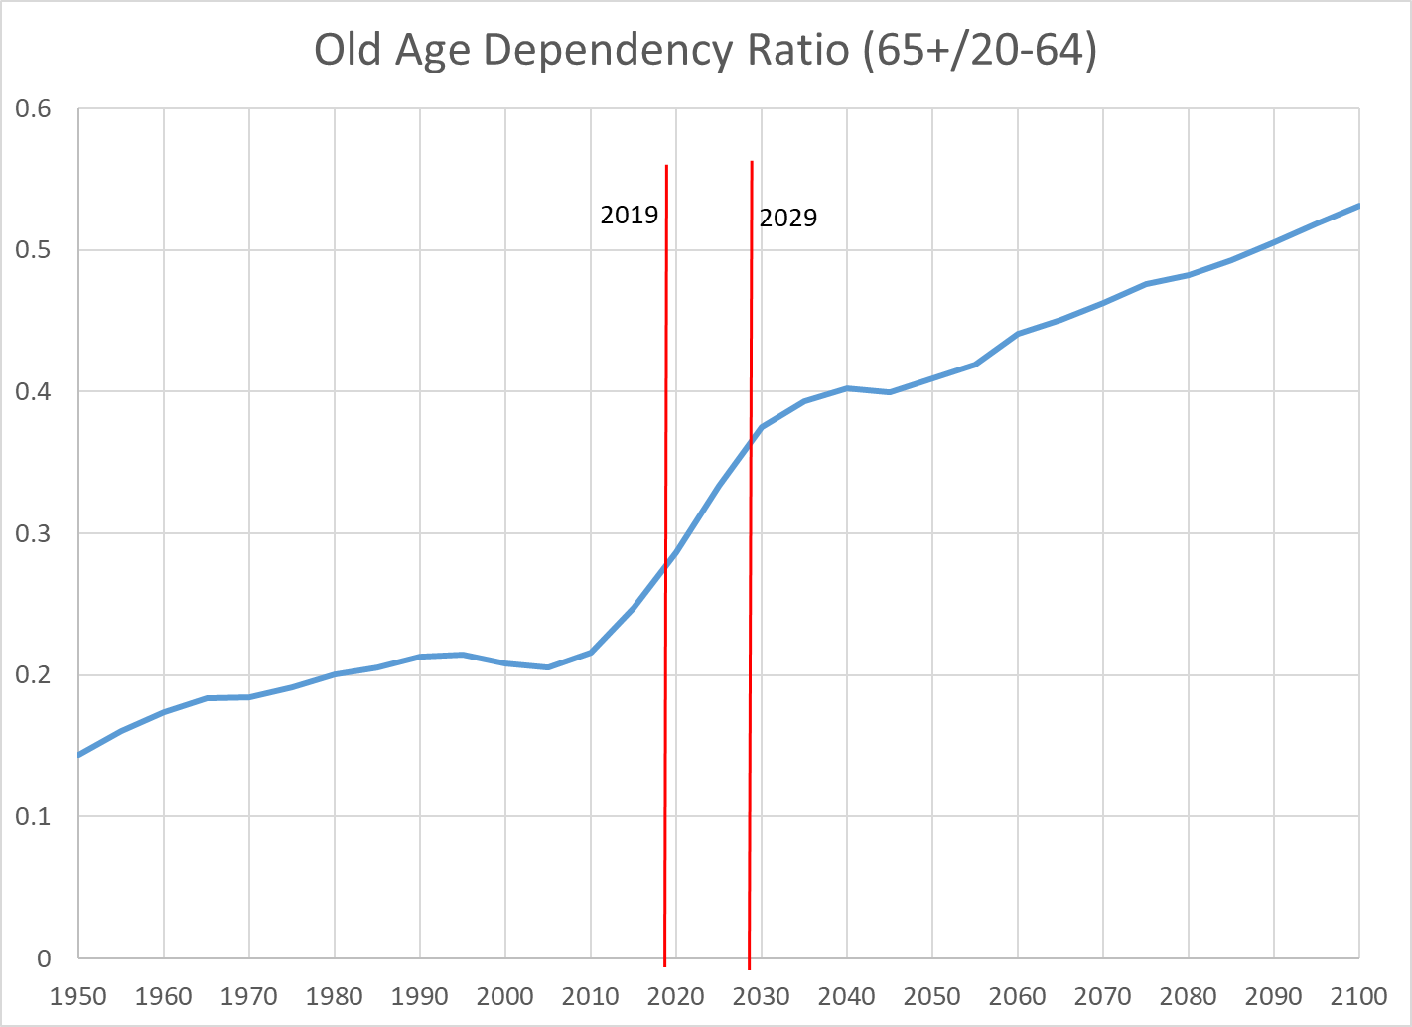
Population Aging, 1950-2015 and projected to 2100 (United Nations)

Slide 25
What and when is old age?
Old people are stronger, healthier, and smarter than a few decades ago.
Truth to “70 is the new 60”.
Why healthier now?
  Better nutrition when young
  Better health care when young
  More education
  Better health care today
Chronological age vs functional age
Proportion of disabled people needing care is not rising.
But now pre-old adults are more obese, have more diabetes, higher disability.
Outlook is uncertain.

Slide 26
3. Economic behavior varies by age

Slide 27
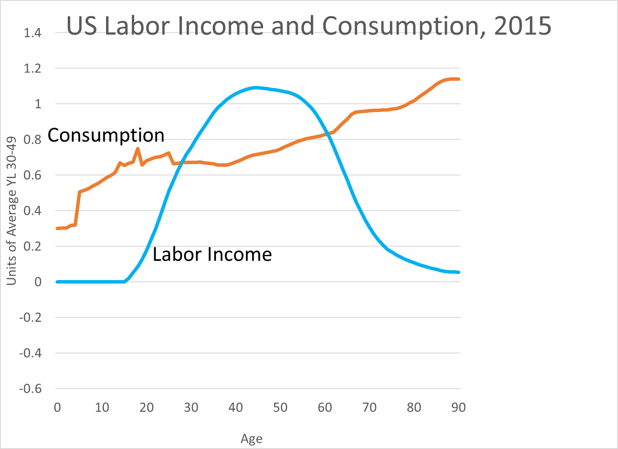
Consumption: household consumption plus in-kind govt transfers (public education, Medicare, Medicaid, etc.)
Labor income wages and salaries plus fringe benefits plus self-employment income (less asset share).
Source: National Transfer Accounts (ntaccounts.org)

Slide 28
Consumption: household consumption plus in-kind govt transfers (public education, Medicare, Medicaid, etc.)
Labor income wages and salaries plus fringe benefits plus self-employment income (less asset share).
Source: National Transfer Accounts (ntaccounts.org)
Gap
Gap

Slide 29
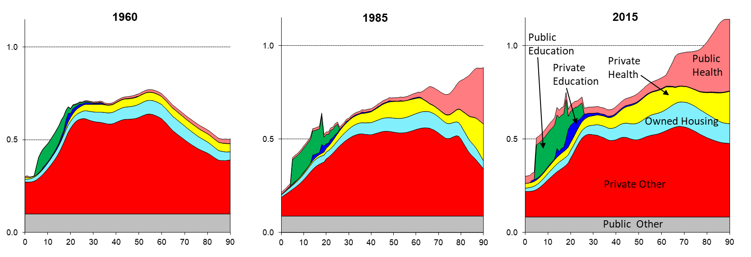
From 1960 to 2015 relative consumption by elderly exploded, largely due to rising public and private health expenditures
Source: National Transfer Accounts data: ntaccounts.org
Y-axis scale: Relative to the (unweighted) profile average of labor income (YL) value for ages 30-49 for that year.

Slide 30
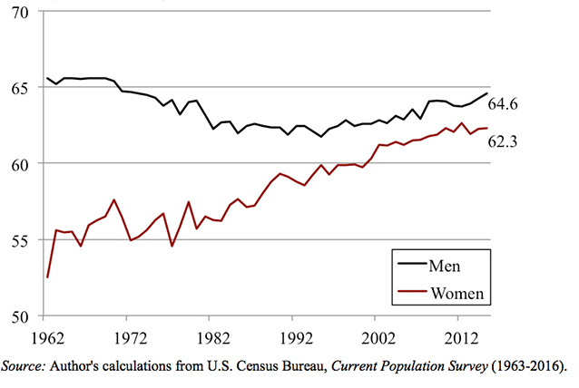
Average age of retirement first fell and since 1995 has risen (1962-2015)
Figure taken from Alicia Munnell (Oct 15, 2017) Market Watch.

Slide 31
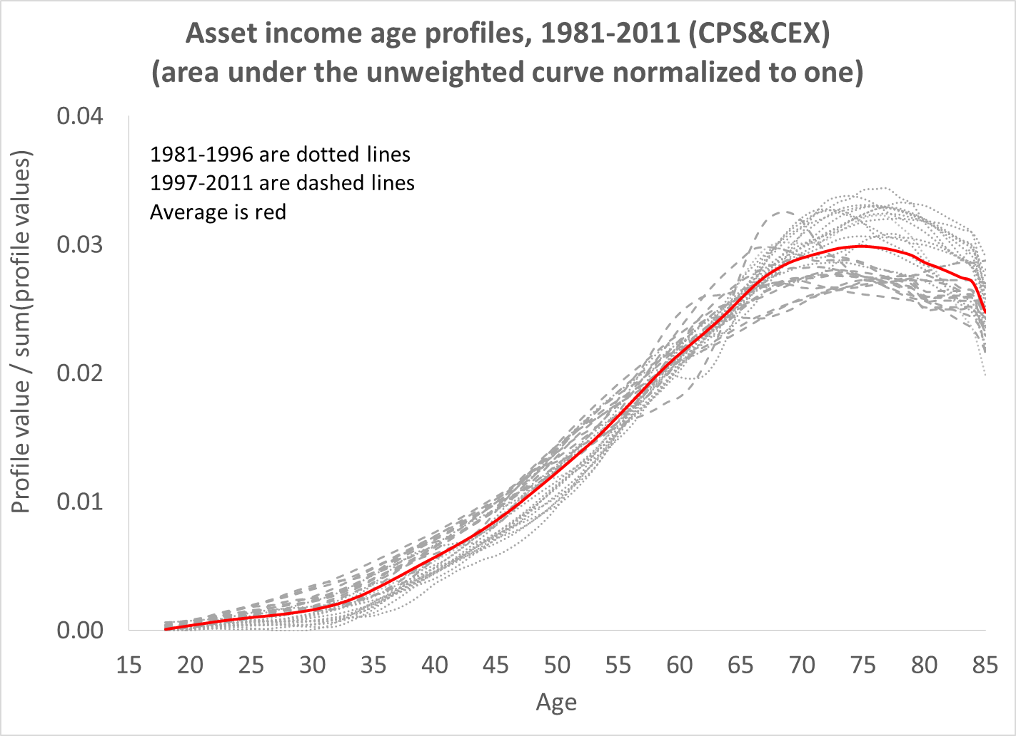
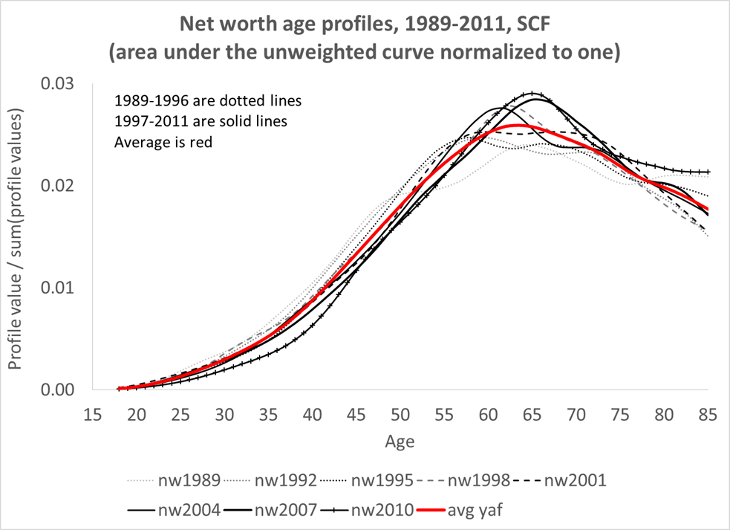
The elderly accumulate and inherit assets throughout life. They hold most assets in the population (asset income and net worth, stable age pattern 1981-2011).
They do not suddenly sell off assets – they keep saving and accumulating in old age.
Net Worth
(level standardized)
Asset Income
(level standardized)

Slide 32
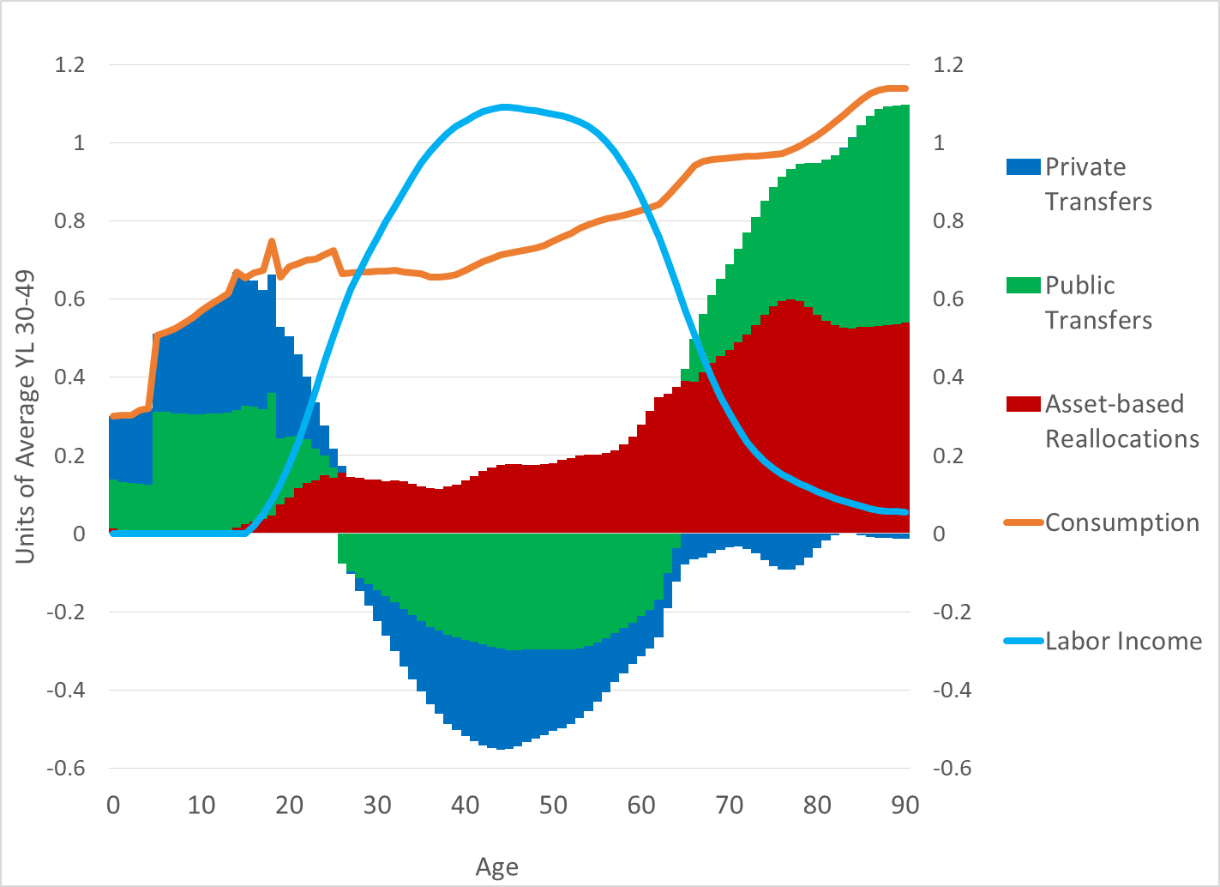
How average individual funds gap in 2015
Asset inc – savings

Slide 33
Elderly (65+) rely 1/3 on govt transfers, 2/3 on asset income
Unique among rich nations; most rely very heavily on net public transfers
Elderly still make net private transfers to their children and grandkids
Asset inc – savings

Slide 34
Kids are funded 50-50 by family transfers and public programs, mostly public education
Adults support kids, pay taxes, and use asset income + working
Asset inc – savings

Slide 35
3. Population aging slows economic growth through market processes
Aggregate economic gr (e.g. GDP growth) declines roughly one-for-one with the rate of population growth in long run. Theory and empirics.
Population aging might have only slight effect on income per capita.
  Slower labor force growth and population aging raise capital intensity (ratio of capital to labor) unless international markets completely dominate domestic markets for capital and labor.
  Higher capital intensity leads to higher wage rates and lower interest and profit rates, other things equal.

Slide 36
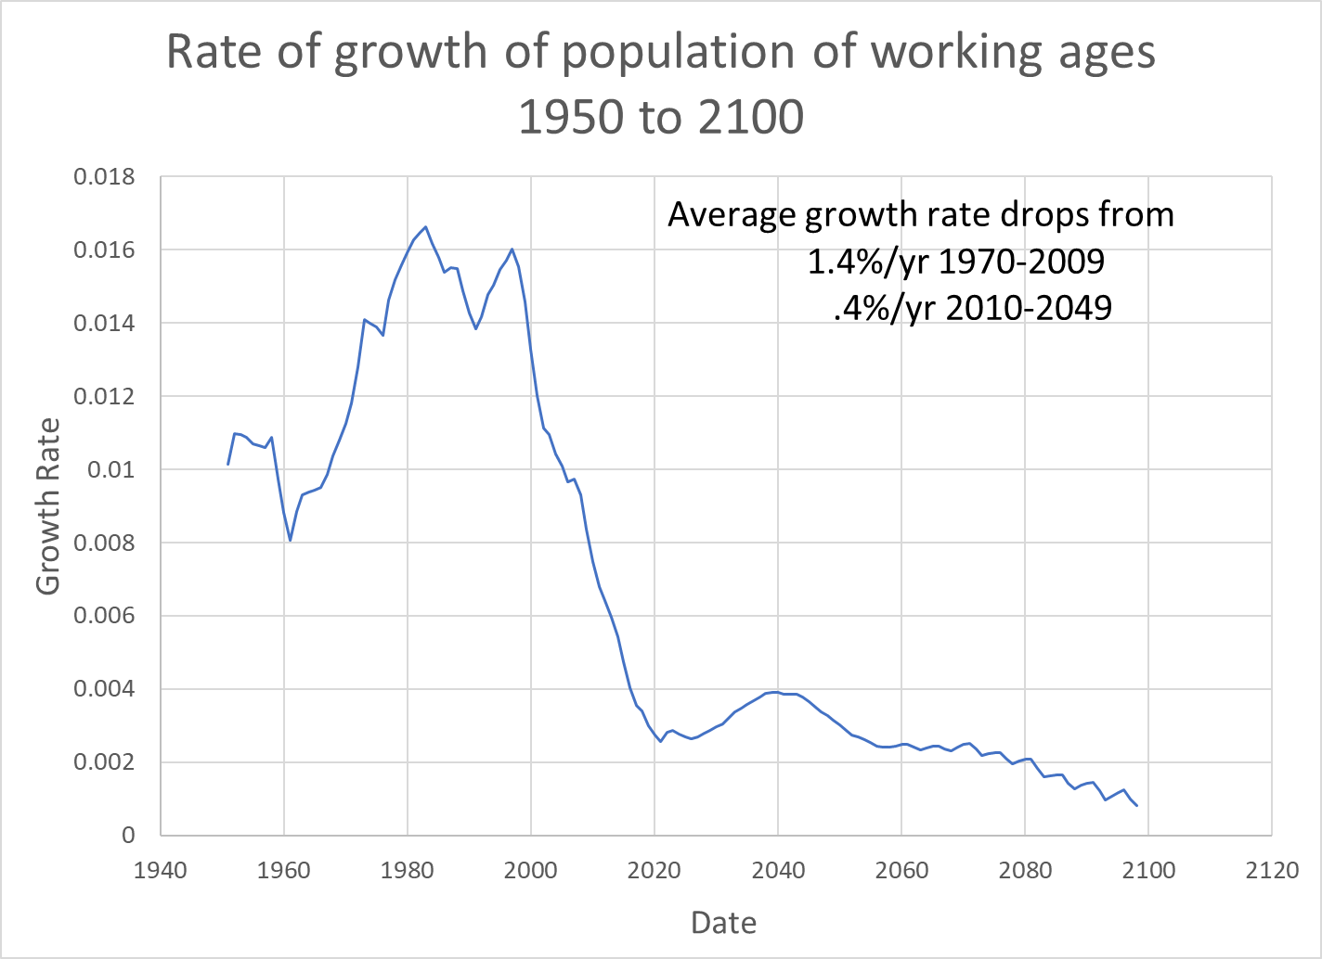
Slowing labor force growth is part of pop aging
Here population is weighted by labor income to get labor force
Growth rate drops by 1%/yr (that is .01)
That translates into 1%/yr drop in growth rate of GDP.
With 1.6%/yr productivity growth rate, we get GDP growth rate of only 2%/yr in future.
(CBO projects 1.9% GDP growth)

Slide 37
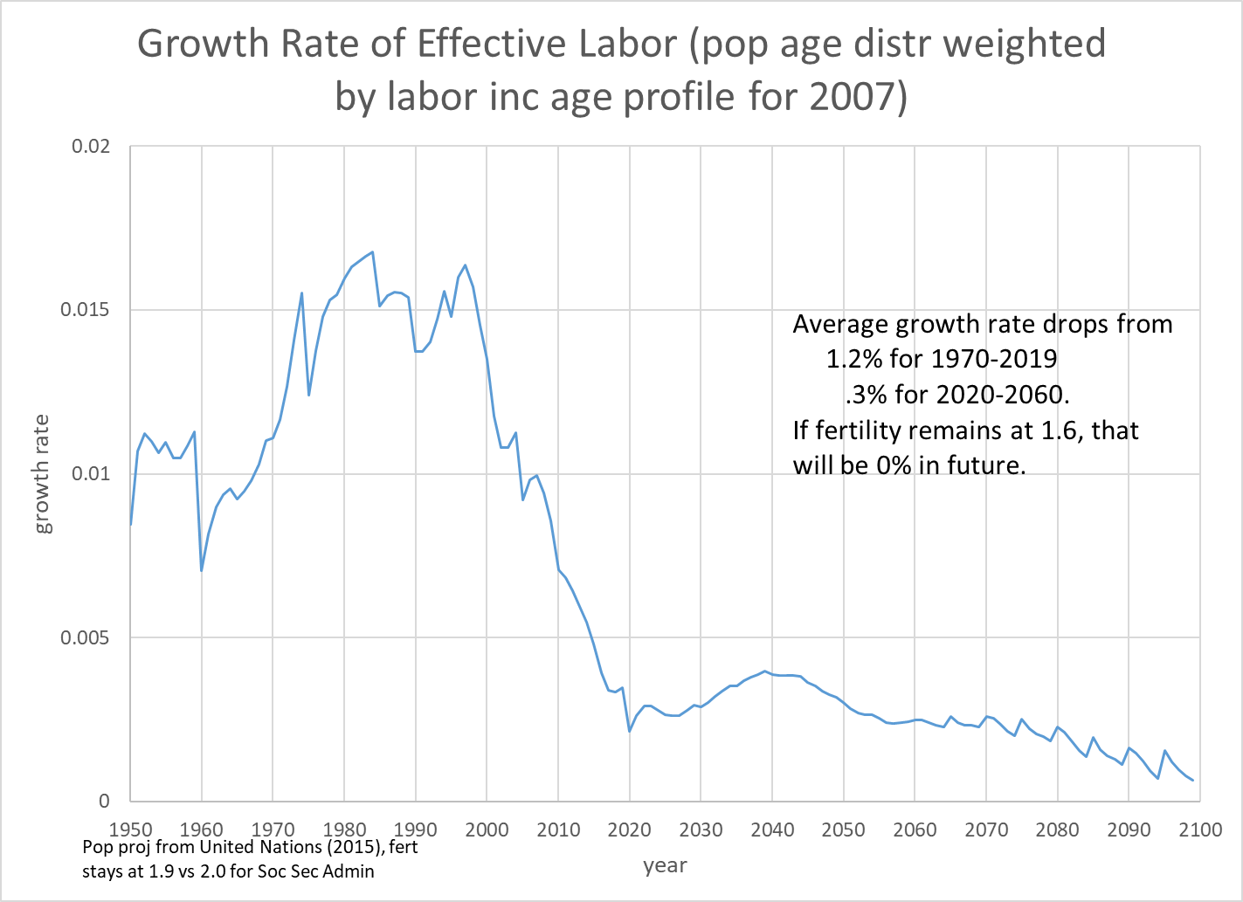
Slowing labor force growth is part of pop aging
Here population is weighted by labor income to get labor force
Growth rate drops by 1%/yr (that is .01)
That translates into 1%/yr drop in growth rate of GDP.
With 1.6%/yr productivity growth rate, we get GDP growth rate of only 2%/yr in future.
(CBO projects 1.9% GDP growth)

Slide 38
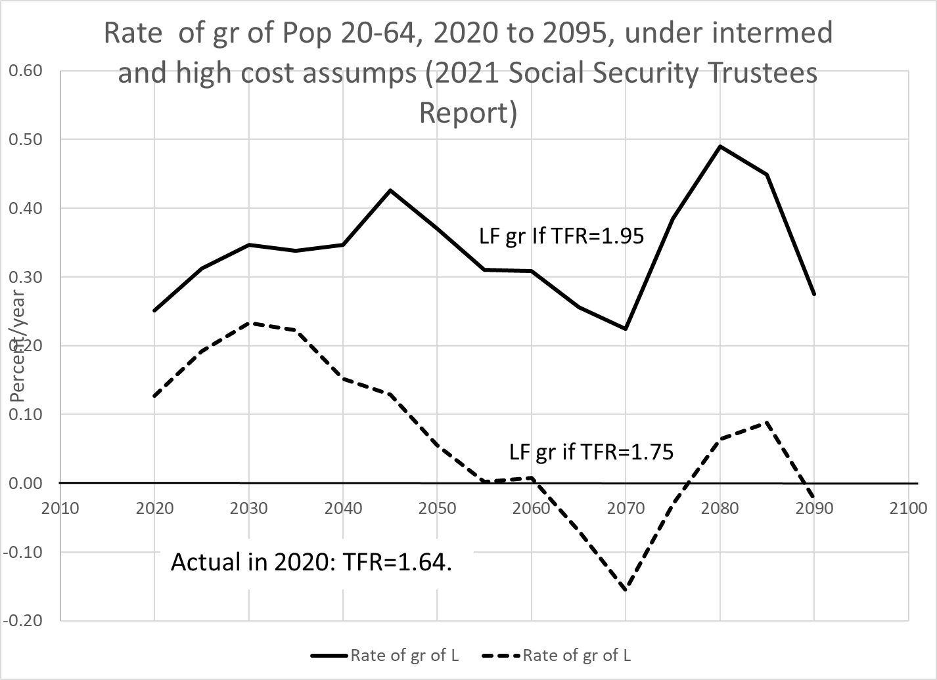
However – now looks like it may go negative!

Slide 39
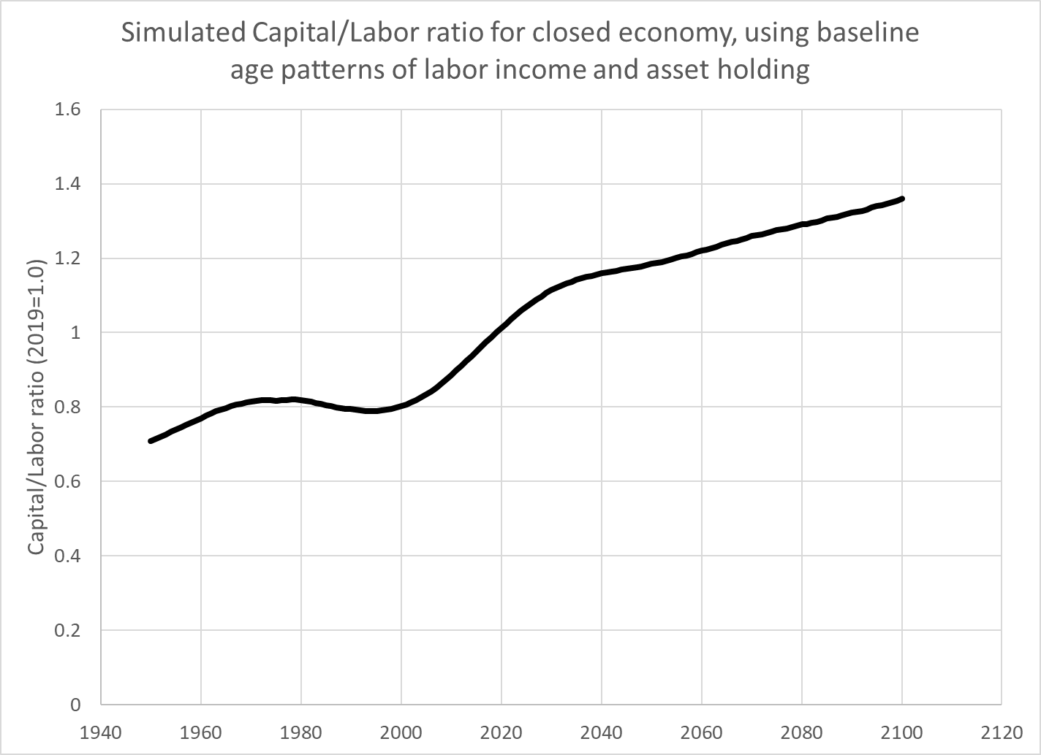
Increase in elderly population and slowdown of labor force growth will drive up capital labor ratio
Simulation is based on asset holdings by age relative to labor income by age at baseline.

Slide 40
2019
2029
10% increase in next decade

Slide 41
2019
2050
20% increase by 2050

Slide 42
2019
2050
Rising capital intensity:
3% wage increase in decade, 7% by 2050
7% interest rate decrease in decade, 14% by 2050
Rise of w/r of 10% in decade, 20% by 2050.

Slide 43
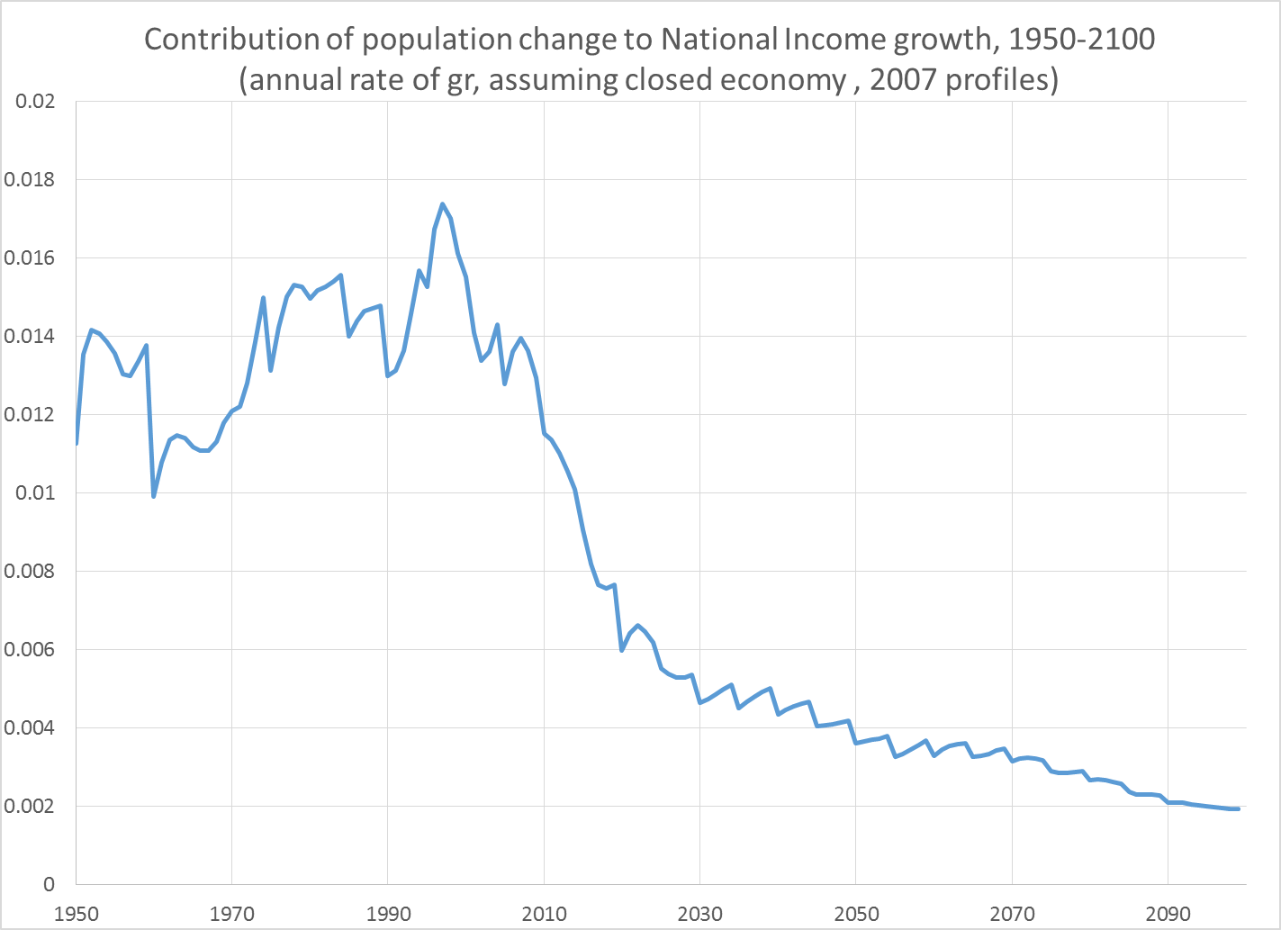
From 1970 to 2000, movement of Baby Boom through age distribution added about 1.5% per year to economic growth.
Smaller post BB cohorts entering LF and large BB cohorts retiring slow LF growth after 2000.
Aging Boomers bring more capital and raise asset income.
Pop change adds about 1%/yr less to Nat Inc gr from 2000 through 2020.

Slide 44
5. Population aging also puts pressure on non-market processes – public programs
About half of GDP is redistributed and consumed by a different person than produced it.
  Some is within family (raising kids, non-working spouse, bequests).
  Some is by government (public education, Social Security, Medicare, Medicaid).
Older people both give (taxes and family assistance) and receive. On average they are net receivers from government.
Population aging means more elderly per worker, and more receivers per giver.
Adjustment is needed: either higher taxes, lower benefits, or some of both.

Slide 45
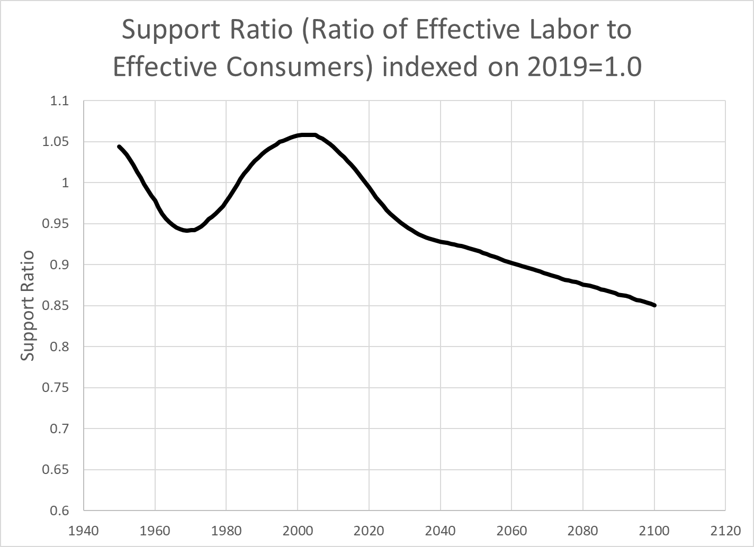
Support Ratio = (effective labor)/(effective cons) is standard measure of impact of pop aging through rising dependency
Uses age profiles of labor income and consumption as weights

Slide 46
This decline measures effect of rising old age dependency
2019
2060
Consumption needs are rising faster than labor force as the population ages.
Other things equal, age adjusted consumption will rise .25% slower than per capita income.
This is the aging impact that draws most concern.
Av decline is .25%/yr

Slide 47
Even if per capita income stays the same (National Cons/Pop), consumption by age will have to decline
Older people consume more than younger people, so even if per capita income stays the same, population aging will mean that all ages will need to consume somewhat less.
This is what falling support ratio tells us.
If we combine the falling support ratio with rising capital intensity, we find a small negative effect of demog change on consumption, of .1 to .2 %/yr. Very little.

Slide 48
A different approach also finds no relation of pop aging to growth rate of GDP per capita
Source: Acemoglu & Restrepo, American Economic Review: Papers & Proceedings 2017, 107(5): 174–179.

Slide 49
7. Basic message for US
Population aging is coming fast, here and abroad.
Little effect on per capita income, most likely.
GDP growth will slow in line with slowing labor force growth
Assets will grow relative to GDP; wages will rise relative to interest rates and profits.
Rising wages and falling profit rates may reduce inequality.
Biggest problems will be fiscal pressures on public programs for the elderly, particularly health care.

Slide 50
Now turn to the global economy and the forces of demographic change (second part of talk)

Slide 51
1. Demographic transition – populations move from high fertility and mortality to low
In middle, support ratio rises as shrinking share of dependent children leads to rising per capita income, “demographic dividend”.
Later, support ratio begins to fall as rising share of dependent elderly leads to falling per capita income, “population aging”.
Different countries started the transition at different times.

Slide 52
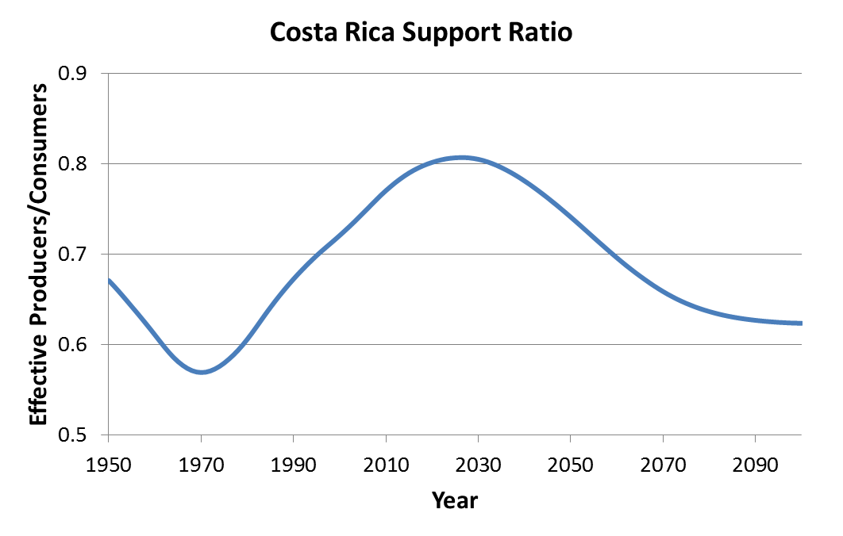
Shape of demographic transition is standard.
Details differ across countries because of:
*When they start process.
*Speed and depth of fertility decline
*Baby booms and busts superimposed.
Position of some pops on demog transition today.
+ means demog benefit; - means loss.
India (DD +)
China (0)
Hi Inc (Aging -)
Niger (-)
Based on UN pop data and forecasts, and estimated consumption and labor income age profiles for Costa Rica by Costa Rican country team, led by Luis Rosero-Bixby.

Slide 53
2. Consequences for global GDP growth

Slide 54
Average per capita labour income by age for countries by income group
(expressed for each country as ratio to average labour income ages 30-49, 160 countries)
Source: Figure 1 in United Nations
Department of Economic and Social Affairs Population Division,
Technical Paper No. 2017/1
“Support Ratios and Demographic
Dividends: Estimates for the World”

Slide 55
Use these to find effect of population on global GDP
Calculate “effective labor” in ppp adjusted monetary units for each of 186 countries
  Multiply pop age distribution times NTA labor income age profile and sum.
  Do for past, present and future UN pop data.
  Gives total labor income in each year if only demography varies
Add these up across all countries to get global labor income estimate net of productivity growth. Just demography.
  Reflects demographic change in each country
  Reflects productivity differences across countries.
Assume labor income is fixed share of GDP (not quite true).

Slide 56
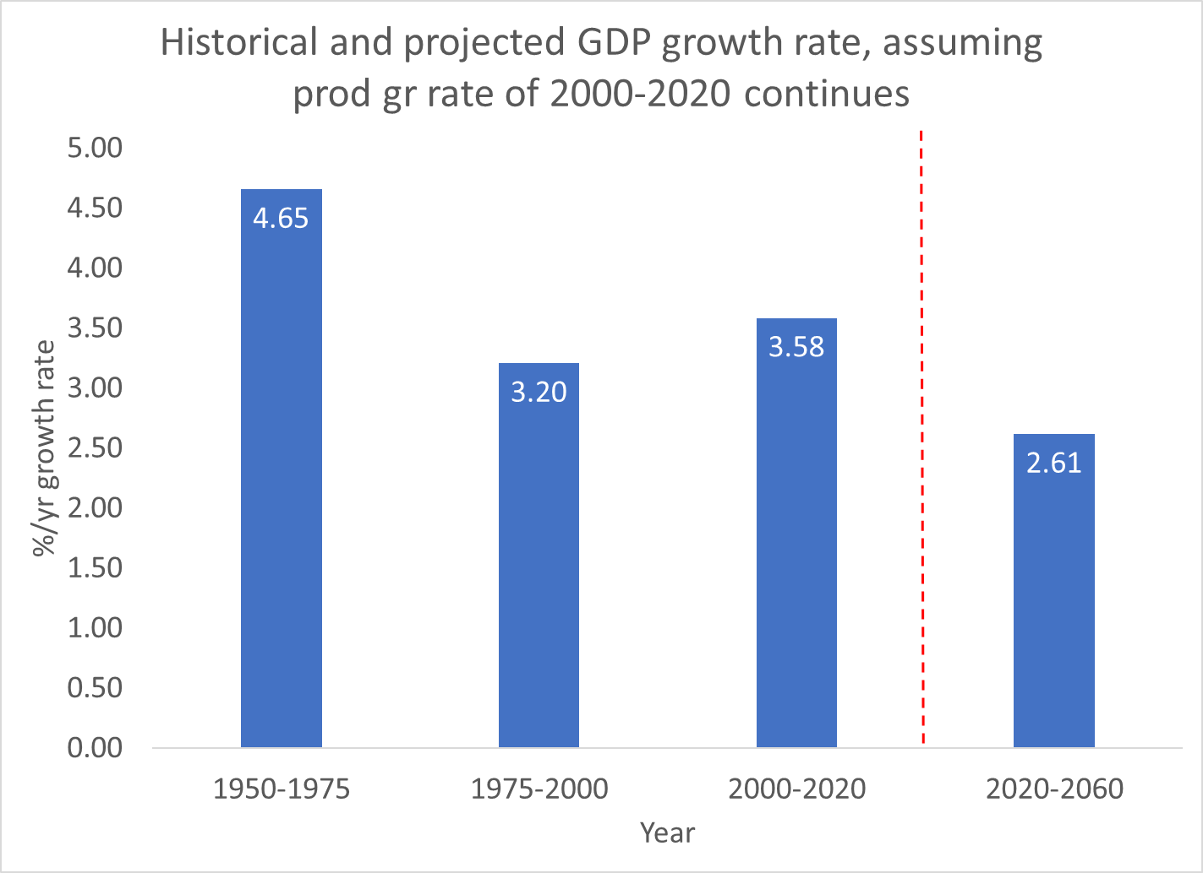
From Maddison, World Bank etc.
Then our projection.
Global GDP growth rate

Slide 57
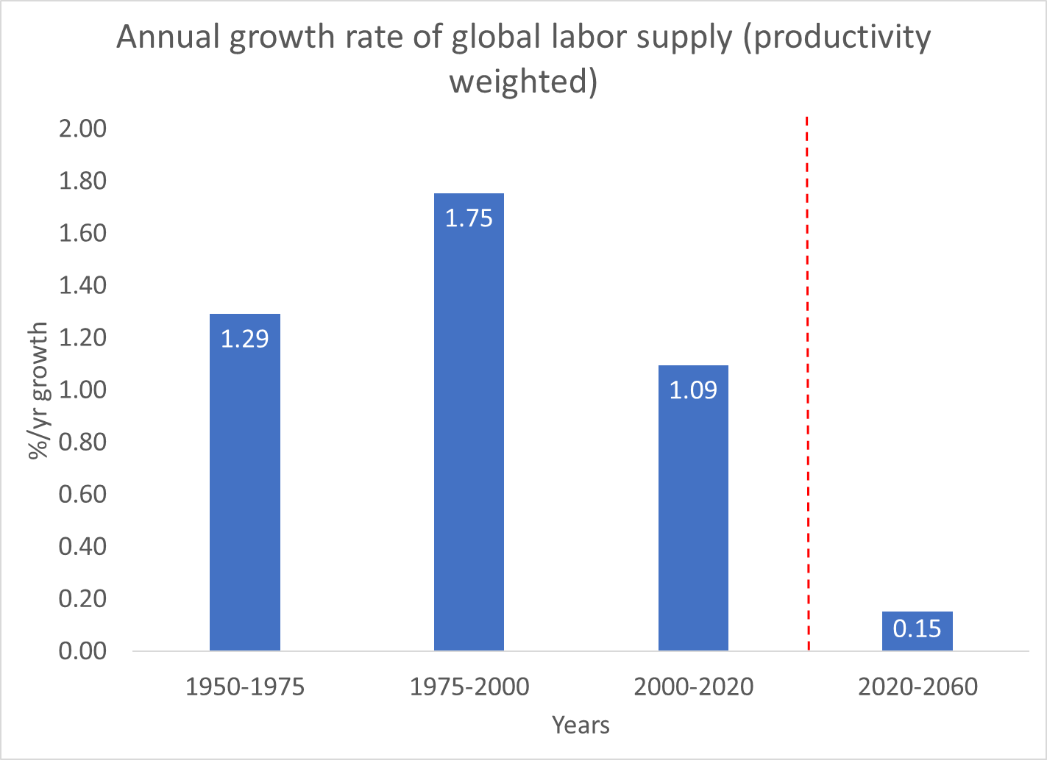

Slide 58
Why does growth rate of global labor supply drop so low (to .15%/y)?
Rapid labor growth is occurring in Sub-Saharan Africa, but productivity is very low so it has little impact on global GDP growth.
Slow or negative labor growth is occurring in high productivity countries (Europe, N. America, E. Asia, etc.) with big impact on GDP growth.

Slide 59
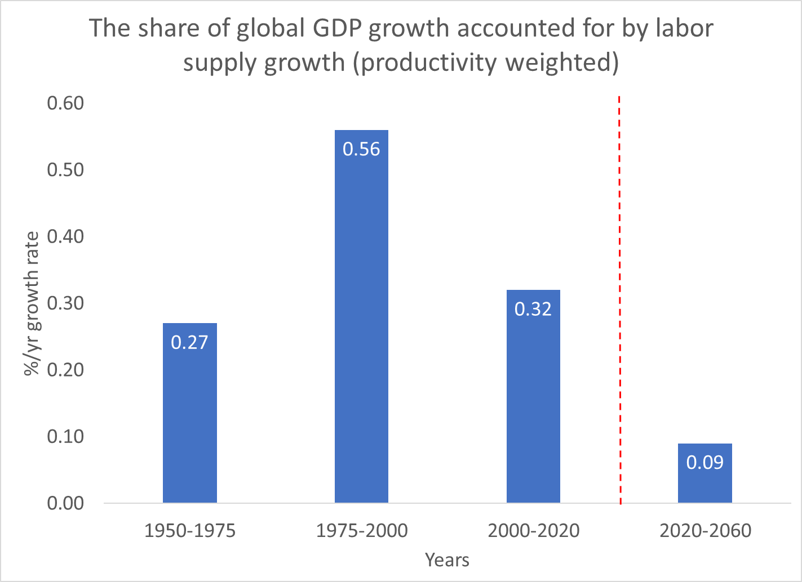

Slide 60
Era of population driven global GDP growth is over!
Share of population in driving GDP growth drops from more than half in 1975-2000 to less than a tenth in 2020-2060.

Slide 61
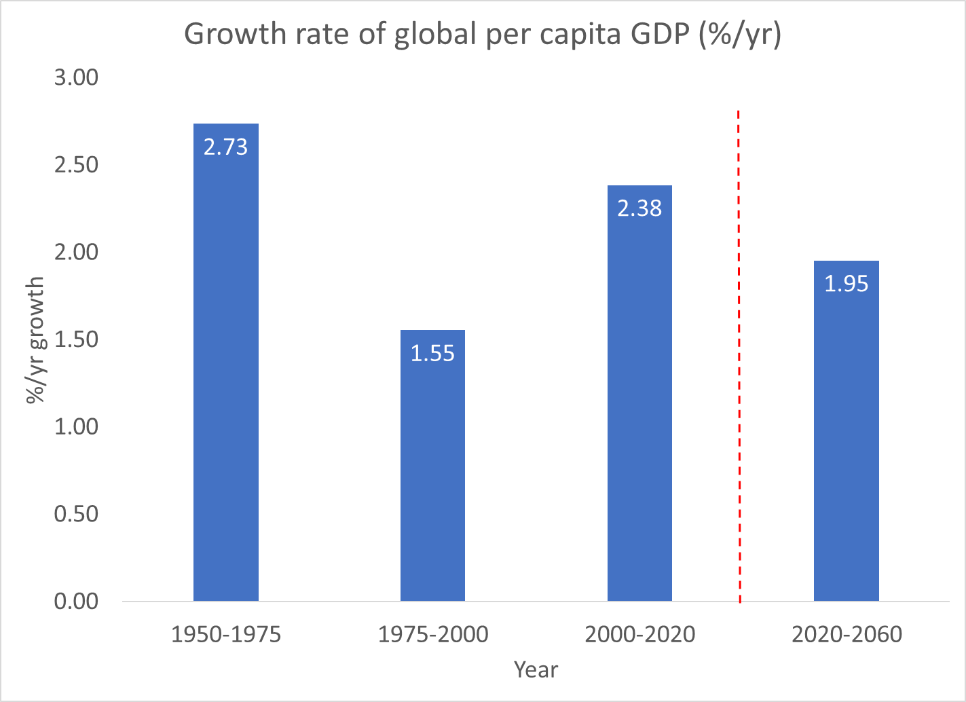

Slide 62
Per capita GDP growth will be much less affected.
Relative to 1975-2000 it will grow .4%/y faster in 2020-2060.
In individual countries per capita income growth rate will be little affected.

Slide 63
3. Most worries about pop aging are due not to the production side, but to redistribution
Age profile of labor income very different than profile of consumption.
Children and elderly consume much more than they produce.
Assets and asset income helps support the elderly, but
In most countries, public transfers fill most of the gap
  Public pensions
  Public health care
  Public long term care
For children, public education and public health care are most impt.

Slide 64
Average per capita consumption by age for countries by income group
(expressed for each country as ratio to average labour income ages 30-49, 160 countries)
Source: Figure 2 in United Nations
Department of Economic and Social Affairs Population Division,
Technical Paper No. 2017/1
“Support Ratios and Demographic
Dividends: Estimates for the World”
Per capita consumption by age, for income groups.
Includes both private household cons and in-kind public transfers (health, education)

Slide 65
Why is this a concern?
When a population ages there are more elderly consuming more than they produce, and fewer workers producing more than they consume.
Something has to give – either workers make bigger transfers (e.g. with higher taxes) or elderly receive smaller benefits (e.g. lower pension or later retirement).
This is the main concern with population aging.

Slide 66
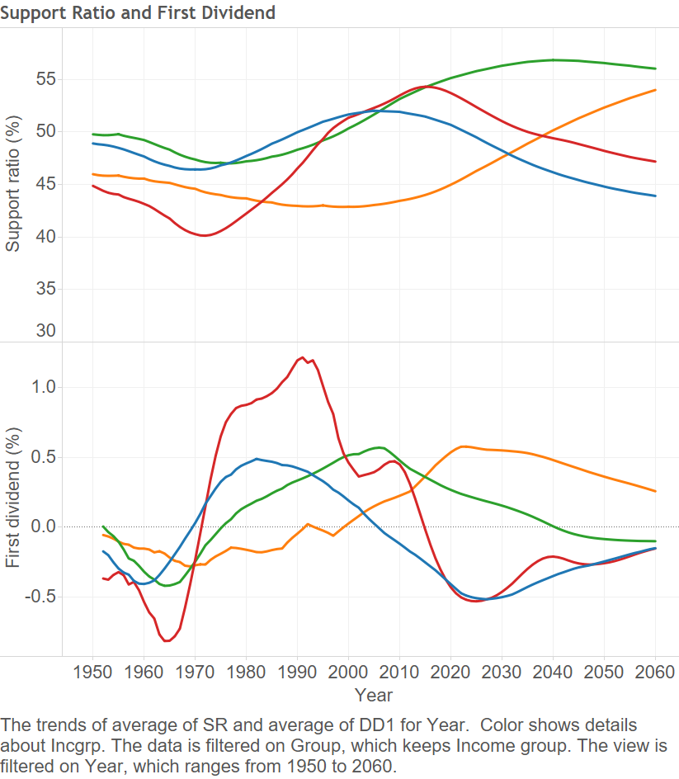
In China there is a “Great Reversal” after 2013. From plus 1.5%/yr demog dividend to -1.0%/yr percent from pop aging.
Elsewhere, more complicated.
On global scale, supp ratio stops rising around now.
But Hi Inc countries have been aging for awhile.
Low Inc and Lower Mid Inc countries still in dividend phase.
Support Ratio
Low-Mid Inc
Low-Inc
High Inc
Up-Mid Inc
Demog Div = change in Supp Rat
Up-Mid Inc
Low-Inc
Low-Mid Inc
High Inc

Slide 67
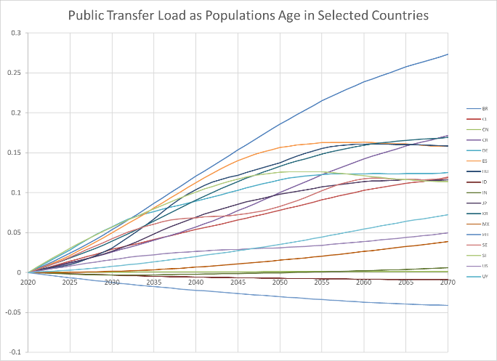
Aging pops bring rising public transfer loads in most countries, 2020-2070.
“transfer load” is net total transfers divided by total consumption.
Consumption must be reduced by this proportion to balance public transfers (benefits – taxes).
Very modest for US.
Brazil 28%
Spain 16%
Japan 17%
US 5%
Philippines -7%

Slide 68
4. Taking capital into account, same approach as earlier for the US

Slide 69
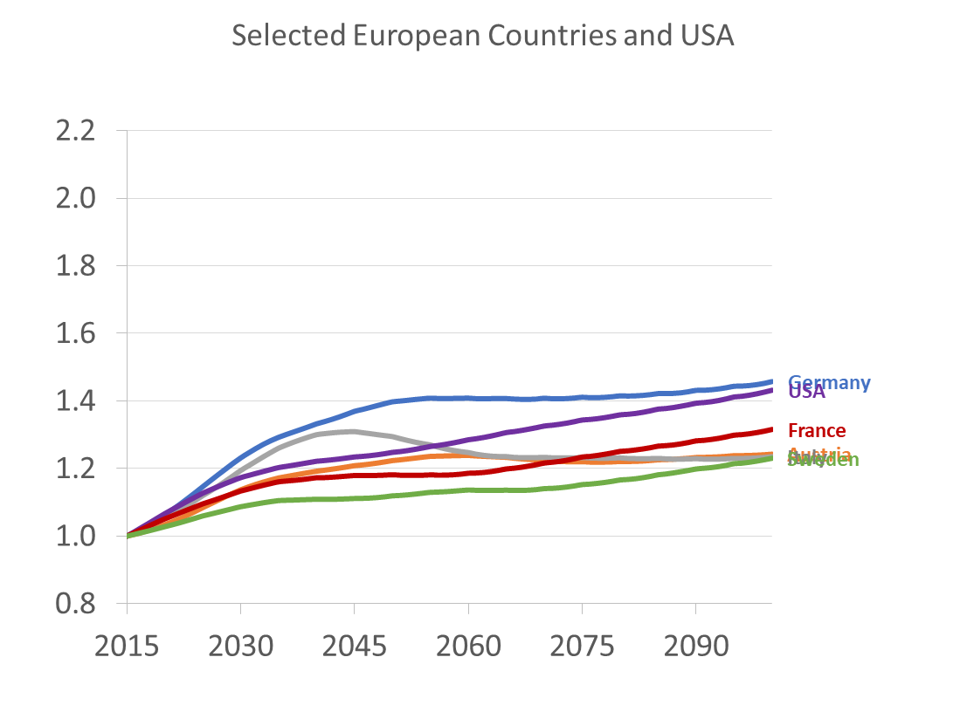
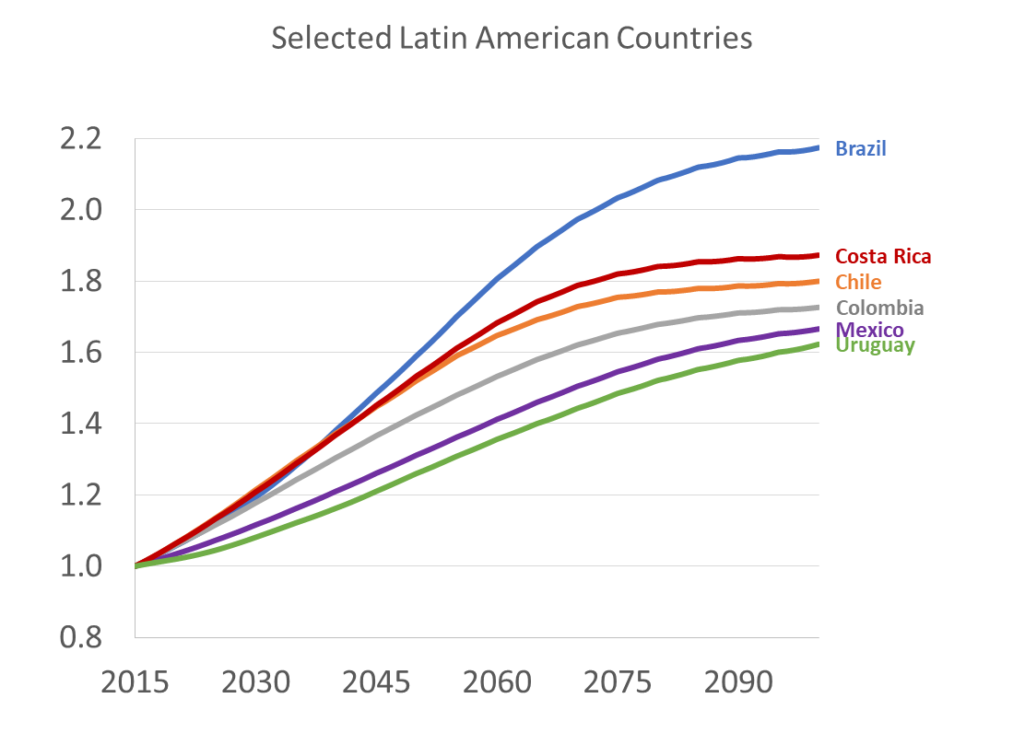
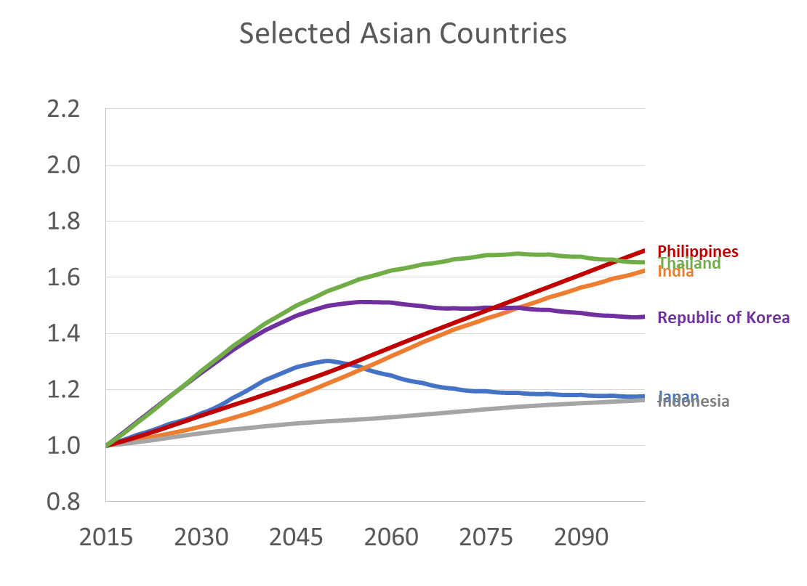
For closed economy, simulated ratios of capital to labor (K/L) and also Wage to Interest Rate (w/r) relative to 2015 = 1.0 for both based on NTA data, assuming Cobb-Douglas production function.
Europe & US
Latin America
Asia
Brazil
Philippines, India, Thailand
Chile, Costa Rica
Germany, US
Mexico, Uruguay
Sweden, Austria, Italy
Japan, Indonesiab
When pop aging raises capital more than labor, the “capital intensity” of economy rises.
Labor productivity and wages rise, interest rate falls.
Countries with biggest increases in K/L are earlier in demographic transition.

Slide 70
8. Discussion/Conclusions
China reached a real demographic “Reversal” (in 2013 for Support Ratio) slowing growth of GDP and income per consumer in China.
Rest of world’s population is mix
  low inc countries benefit from demographic dividends
  high inc countries see costs of continuing population aging.
Relative to 1975-2000, future population change slows global GDP growth by 1.6%/y. But per capita GDP will grow somewhat more rapidly.
Interest rates will continue to fall as more elderly bring more assets.
Real wages will rise due to more capital per worker in addition to technological progress.
Higher real wages and lower returns to capital should reduce income inequality.
Capital may flow from aging rich countries to lower income countries with lots of labor and not much capital. But many risks and underdeveloped infrastructure and financial markets.

Slide 71
END

